Slide 1

Machine Translation (Romanian to Romani translation)
Zibileanu Sabin (512)
Grigore Dragoș - Gabriel (512)
Vasilescu Costin – Tiberiu (507)
Handac Alexandru - Radu (507)

Slide 2
TABLE OF CONTENTS
1. Introduction
2. Data acquisition
3. Tokenization
4. Approach + Results
5. Limitations
6. Conclusions
7. Bibliographic references

Slide 3

INTRODUCTORY NOTES

Slide 4
A gentle start
We present the steps and the tools necessary to build a machine translation deep learning model for Romanian to Romani. Even though it is a low - resource language, the Romani language is a very popular one around the world.
This presentation covers modern deep learning approaches that can be a building block for future research on this language.

Slide 5
Data acquistion

Slide 6
DATA ACQUISITION
The data was obtained from different sources, those being:
- Glosbe
- Romani courses
- Romani conversational guides
- Romani dictionaries
- Dataset from HelsinkiNLP

Slide 7
HOW DID YOU BUILD THE CORPUS??
Working with a low-resource language we took into account the fact that we had to build a corpus from scratch almost. however, we found a corpus online with around 7900 samples from Romanian to Romani from HelsinkiNLP which to our knowledge is in the Carpathian Romani dialect.
To add more data, we scraped samples from Glosbe as it provided Carpathian Romani samples translated into Romanian.
Next on, we manually gathered a set of samples from different dictionaries, conversational guides, and a Romani course support.

Slide 8
TOKENIZATION

Slide 9
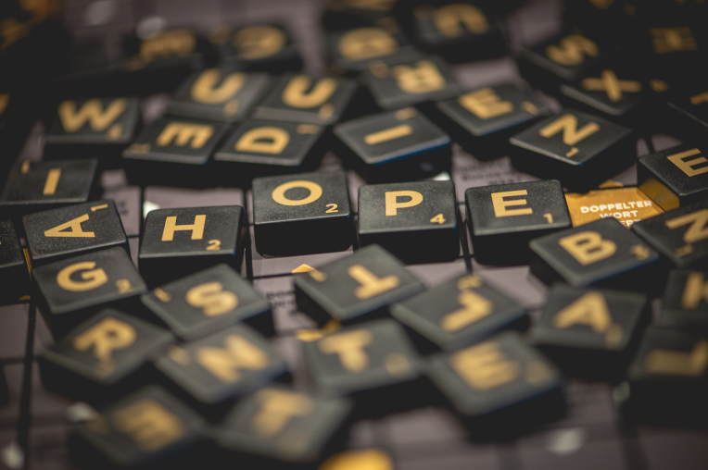
TOKENIZATION
There were 2 different tokenizers that we built: one is a custom SentencePiece tokenizer with a vocabulary size of with respect to the size of the unique tokens in the corpus, ~10000, while the other one is a pre trained tokenizer that we extended with this custom SentencePiece tokenizer.

Slide 10
APPROACH AND RESULTS

Slide 11
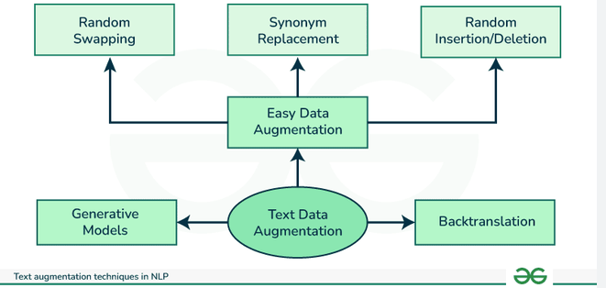
DATA AUGMENTATION
We felt that it was necessary to try and use some data augmentation techniques, especially working with a low resource language. The techniques that we used were:
Back translation
Sentence insertion
Random character insertion
The augmentation was done on 15% of the dataset.
Source : GeeksForGeeks

Slide 12
APPROACH
Our approach involved using the MarianMT model and using 2 different variatons when it comes to the initialization of the model. Precisely, we used a MarianMT model with our custom tokenizer and a pre-trained MarianMT model with the already existing tokenizer that we combined with the custom one. Precisely we extended the already existing pre-trained tokenizer with our custom made Romanian to Romani tokenizer.

Slide 13
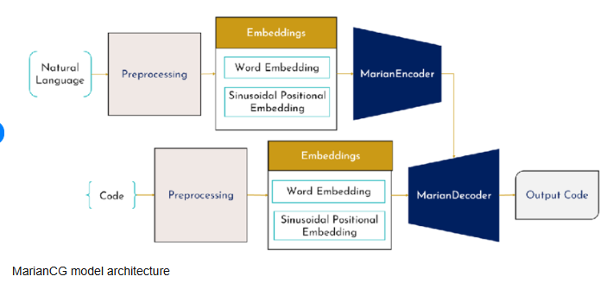
WHY MARIANMT?
We chose this approach because the MarianMT model supports multiple romance languages and it is also a very well structured Sequence2Sequence model for machine translation.
MARIANMT visual representation
Source: ResearchGate

Slide 14
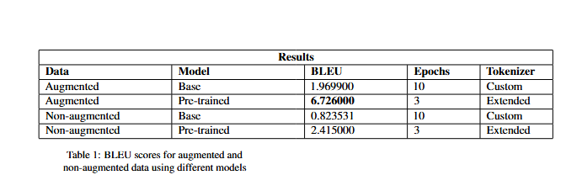
RESULTS
Somewhat expected results, especially for a low resource language and a relatively small corpus. What can we notice is that the pre-trained model with the extended tokenizer might be the way to go.

Slide 15
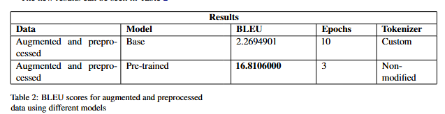
RESULTS
Furtherly ehanching our experiments with different environments, those being: using the custom created tokenizer with the base model and with the removal of the diacritics for the Romani data and using the already existent tokenizer for the pre-trained model with no additional changes and the removal of the diacritics for the Romani data.

Slide 16
TRANSLATION EXAMPLES
Original: Noi toți mergem acolo!
Translation: Ame savorhe zhas!
Original: Ce faci?
Translation: So keres?
Original: Bună dimineața! Ce faci?
Translation: Good morning! So keres?
The results are really encouraging with the exception when English and Romani are combined. This was to be expected knowing the fact that we worked with a model which supports English and Romance languages.

Slide 17
LIMITATIONS

Slide 18
LIMITATIONS
The most notable limitation that can be seen is the quality of the results. This is caused by the low amount of data that was gathered. In order to build a high - standard machine translation model for Romanian to Romani, a large corpus is needed first (millions of sentences) that can be verified by a Romani speaker. It can be built from books, dictionaries, conversational guides and even songs why not.
Another limitation that we found while working on this project was that there are not that many Romani books, that are translated in Romanian (excluding dictionaries).

Slide 19
CONCLUSIONS

Slide 20
CONCLUSIONS
Although the results were far from perfect, the project covered modern approaches to tackling a difficult machine translation problem presenting all the steps and tools that were used, and as a result becoming a building block for future projects and research aimed at the Romani language.
We liked this project because it allowed us to build something from the ground up and learn more about machine translation in the process. We believe that this project will surely leave room for improvement for the future and is a starting point for this task.

Slide 21
BIBLIOGRAPHIC RESOURCES
https://www.academia.edu/43726447/Ghid_de_conversa%C5%A3ie_Rom%C3%A2n_Romano_Rum%C3%AEnisko_Romano_Lumini%C5%A3a_Mihai_Cioab%C4%83
https://ikultura.ro/wp-content/uploads/2019/09/Suport-De-Curs-Limba-Romani.pdf
https://cdn.prod.website-files.com/601e5c899b255f2ab1aa7bd3/618532c3aee2d5be11a853f5_Romanes-with-Rahela-5.pdf

